Slide 1
The Incredibles
Ezra Werlinich, Erich Schwarzrock, Jenna Galli, and Byron Ou
Notes:
Jenna

Slide 2
Presentation Overview
01
02
03
Movie Summary
Conclusion
Technologies
Notes:
Jenna Overview Slide

Slide 3
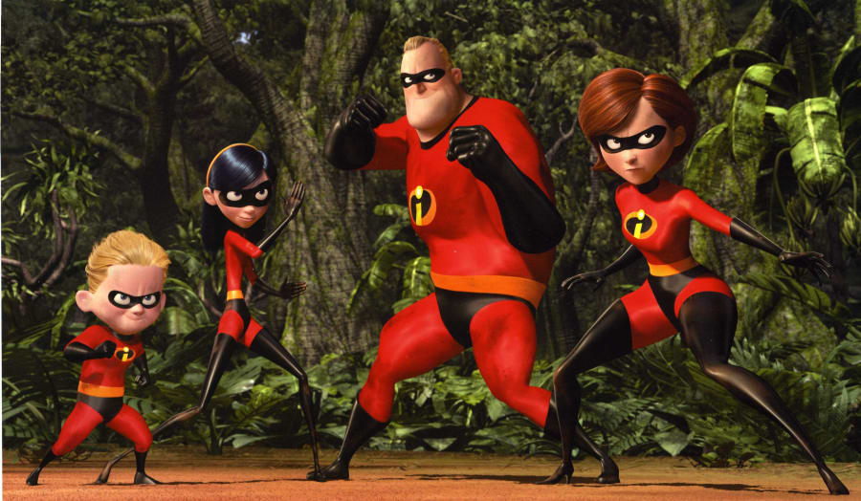
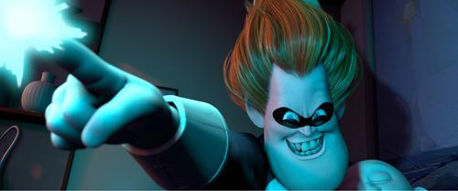
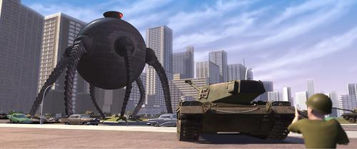
Main Characters
The Incredibles Family
Mr. Incredible
Elastigirl/Mrs. Incredible
Dash
Violet
Syndrome
Omnidroid
Source: The Incredibles(2004)
Notes:
This movie focuses on Mr. Incredible and Elastigirl and their children Dash and Violet. They are a superhero family known as the incredibles and must face off against Syndrome and his Omnidroid. Syndrome is just a normal human, not a superhero, however he is super rich from selling advanced weapons to the government. In order to help him stand a chance against the superheroes he invented a bunch gadgets to give him superhero like powers, like rocket boots, and force field gloves.

Slide 4
Plot Timeline
Before
Superhero Ban
Syndrome’s Invitation
Mr. Incredible works
Syndrome sends the Omnidroid into the city
Mr. Incredible is out saving the day
Superhero Ban
Mr. Incredible got invited from Syndrome
Ending
Notes:
Expand on omnidroid
The movie starts off with a flashback to when Mr incredible and Elastigirl were fighting crime and just got married. Soon after the government decides to ban superheros from helping because the super heroes tend to cause a lot of damage. The movie then skips ahead 15 years to when Mr Incredible and Elastigirl have a family. Mr. Incredible is working a boring 9-5 job and is missing the glory days.Then Mr. Incredible gets offered another super hero job and jumps on it. He is tasked to hunt down and stop a giant robot known as the omnidroid. After that is done it is revealed that Syndrome is the bad guy and wants to eliminate all the superheros. Syndromes main plan is to send his omnidroid into the city to cause mayhem and then swoop in with his inventions to save the day become famous, and then sell his inventions to the public so that everyone can have super powers. This naturally goes wrong and the Incredibles have to save the city from the Omnidroid.

Slide 5
Conclusion
Technology is the great equalizer but needs to be monitored accordingly
The great equalizer
Tech creates more equal opportunity
Syndrome’s goal in the movie
“When everyone’s super, then no one will be”
Need for monitoring
Power corrupts; absolute power corrupts absolutely
Potential misuse of universal superpowers
Tech can be too powerful for average person
Notes:
The conclusion that our team formed about the movie is that technology is the great equalizer, but it needs to be monitored accordingly
Why is it the great equalizer? Well, technology gives a more equal access to basic needs
People with disabilities in ancient times didn’t have technology like modern wheelchairs, hearing aids, contacts, or other things that we deem essential to survive in our modern world
By having access to this tech, it brings those people on an equal footing with those who didn’t have the same difficulties
This is Syndrome’s POV and goal
He views normal humans as extremely disadvantaged when compared to the superheroes
By giving all people equal access to the “super” technology, it will make it so no one has an advantage over anyone else
In theory, this would be a great boon to society
For example, with the zero point energy gloves that will be discussed later, we wouldn’t need heavy machinery for construction, people could fly instead of driving or walking with syndrome’s rocket boots, and so much more
However, this power comes with great responsibility, and it is hard to keep it under control when so many people have access to it
This parallels the gun debate in our present society in the US
When so many people have access to such a deadly tool, it becomes increasingly difficult to prevent the misuse of the guns
Another example in a different vein is the internet anonymity debate that we had in class the other week
Many people believe anonymity to be a right, but many others misuse it to perform illegal actions
It’s the same with the “super” technology
There would need to be some form of regulation to ensure that, a, too powerful of technology is not released to the mass public, and b, there is some form of penalty for the misuse of the tech

Slide 6
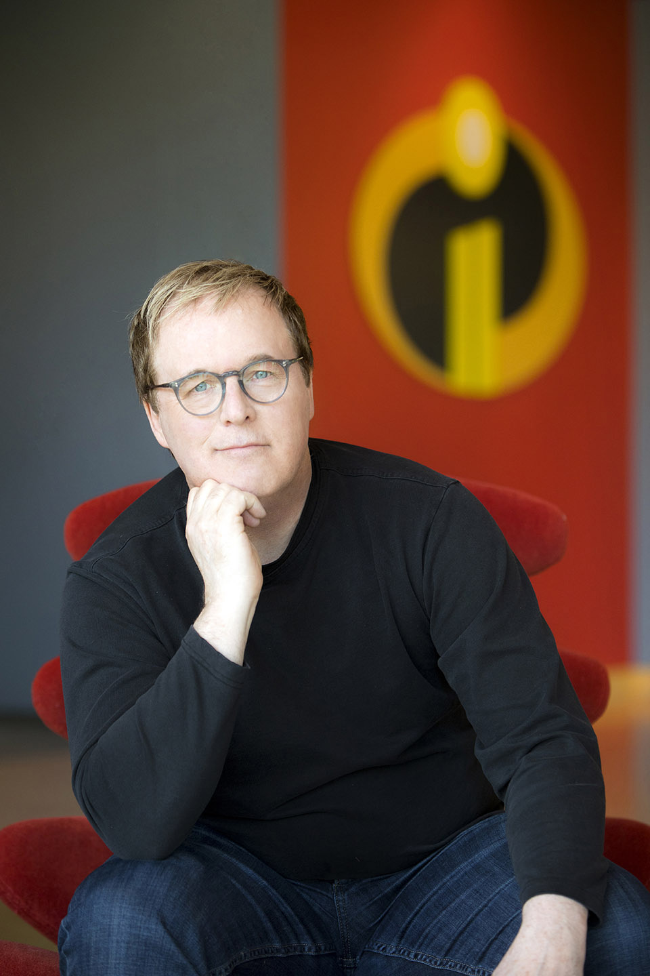
Film Maker’s Intent
Technology portrayed in an evil light
Skeptical of the power and dangers tech brings
Inferior to natural human ability
Brad Bird, writer and director of The Incredibles
Courtesy of Animation Magazine
Notes:
The filmmaker, Brad Bird, had a very different view on technology throughout the movie
He portrayed the technology in the film in a very negative and evil light
For example, the omnidroid, an android with incredibly high-level artificial intelligence and machine learning capabilities, was only used for the killing of superheroes and the destruction of the city that the movie takes place in
He is very skeptical of the power of technology
The movie came out only 2 years after the dot com bubble burst, and society was very distrusting of all technology at the time. The movie reflects this fear
Bird also portrays the technology as inferior to natural human ability
Syndrome’s powerful technology was not able to stop the omnidroid, and it was only defeated through superheroes with natural talent using their quick wit
Technology is shown to be inferior, unreliable, and tools for bad actors
It almost never focuses on the good that it can bring to society

Slide 7
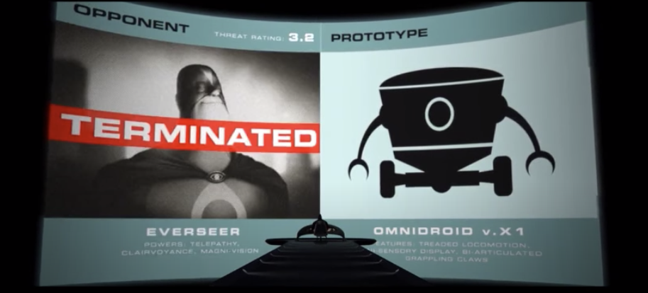
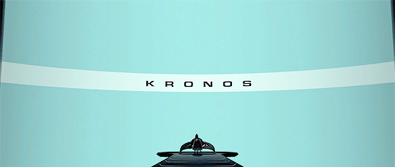
1. Database
Data
Names
Powers
Threat levels
Abuse of power
Hacking
191 million voters exposed [1]
Data mining
Trade Secrets
Information is power
Source: Youtube and Gifer
Notes:
(Jenna)Syndrome’s database
Contains
Superheroes names
Powers and
Threat levels
Important to note superheros were unaware of this data collection
Illegally obtained through hacking
Another example of a database being hacked, was in 2015 when 191 million U.S. voters had their information exposed because the government’s voter database became accidentally public on the internet
Voter’s names, birthdays, and party affiliations became public information which exposed them security risks similar to the risks the superheroes in this film were exposed to.
Omnidroid uses this database to perform data mining by identifying its targets and their weaknesses
abuse of power.
Because syndrome obtained and distributed confidential information.
if the superheroes knew about the data being collected of them, there would be consumer backlash
Can view the database as Trade secrets for syndrome
He Can feed omnidriod this info to help it in battles
What the audience observes is
Syndrome using data as his superpower
With advanced knowledge he’s able to defeat other superheros
This Allows technology to be the equalizer in the fight
Since all the info was hacked, it reminds the audience that while technology can equalize people it needs to be monitored for destruction

Slide 8
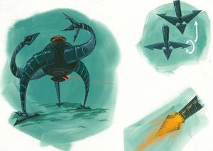
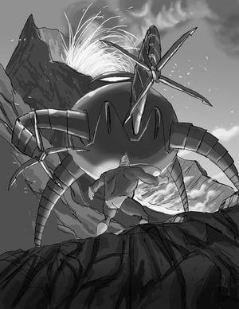
2. Omnidroid
Used as a warning for the dangers of technology
Malfunctioned twice
“Stop Button Problem”[2]
AI needs to be safer
Source: https://www.pixar.com/feature-films/the-incredibles
Notes:
(Erich)
Another example of unmonitored technology that went wrong, was Syndromes Omnidroid. The film uses the omnidroid is used as a cautionary tail, and acts as an example of how, through a lack of security features, technology can go wrong and cause damage. The Omnidroid is powered by an AI system that is able to adapt and learn, but it also had a backup remote installed so that Syndrome could control it and defeat it more easily. However due to a lack of safety features the AI learned it was being controlled by the remote and syndrome. Since syndrome was getting in its way it decided to shoot the remote out of syndrome’s hand. This wasn’t even the first time the AI malfunctioned, Mr. Incredible’s first task was to find the omnidroid because the AI malfunctioned and broke free on the island. Syndrome should have saw the malfunctions, and fixed them before he sent the droid into the city. This problem of advanced AI’s malfunctioning is currently be reassured and is known as the stop button problem. And even without AI involved computer systems still malfunction, like the therac 25 from our book. The omnidroid was used as a cautionary tail in the film to show that technology needs to be fully tested, and treated carefully before it gets put into production, because if it isn’t it will most definitely fail and cause undue harm.
The Omnidroid is a cautionary tail
Ai powered
The AI “malfunctions” twice
1st was to get Mr. Incredible on the island
2nd was when it was in the city and shoot the remote off Syndromes arm
Was not handled correctly
This is a current topic in AI research known as the Stop button problem
With more and more powerful AI’s we need to figure out how to stop this from happening

Slide 9
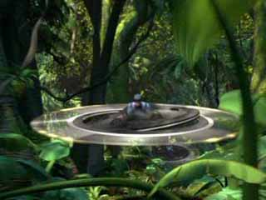
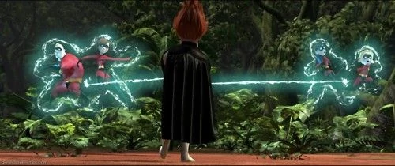
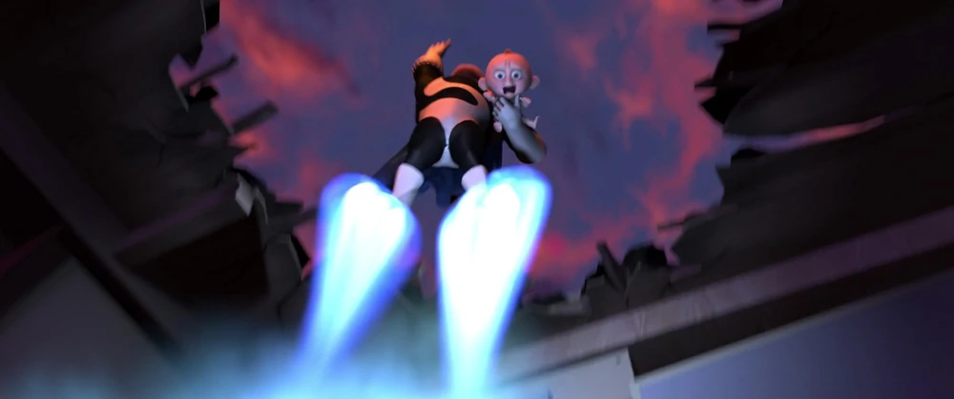
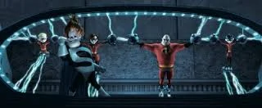
3. Gadgets
Velocipod
Zero point energy field gloves
Rocket boots
Energy Prison
“The incredibles(2004).”
Notes:
Byron
Velocipod: Flyable machine that Employees of Syndrome use to fight Dash & Violet
Rocket boots: Syndrome uses it to fly wherever he wants
Zero point energy field gloves: He uses to disfunction the incredibles
Energy prison: used to prison the incredible families

Slide 10
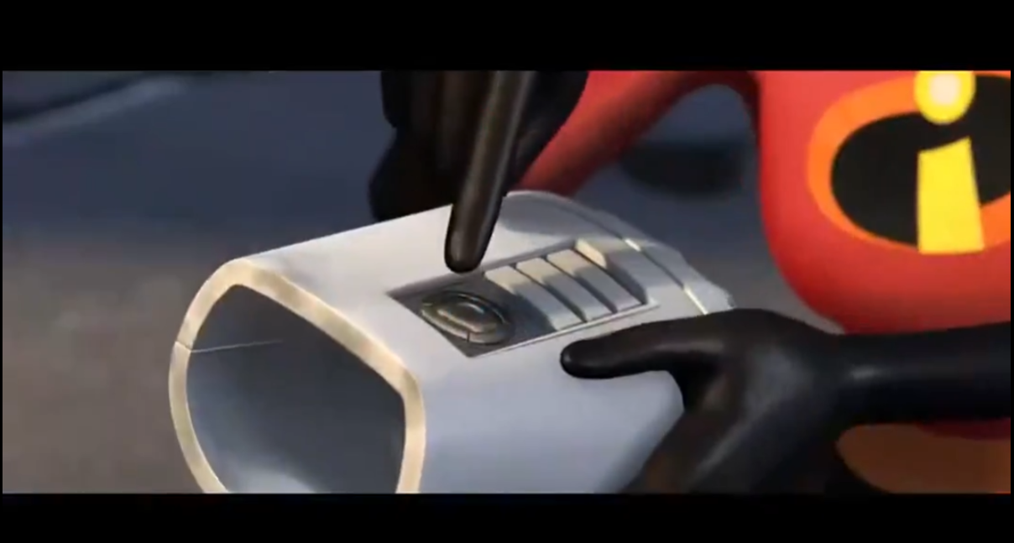
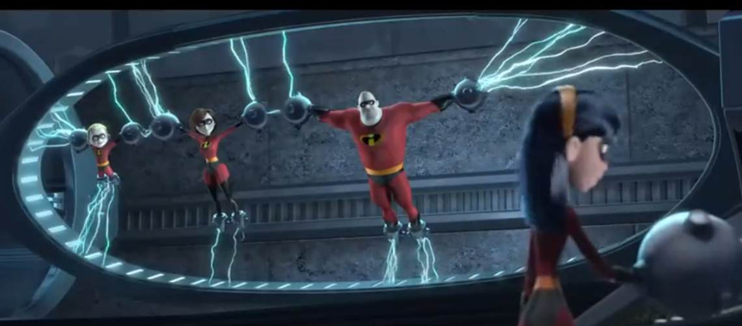
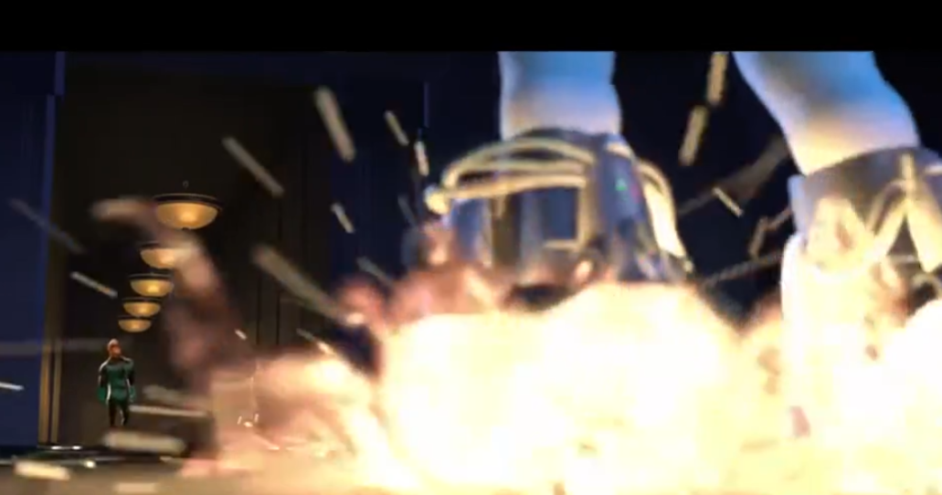
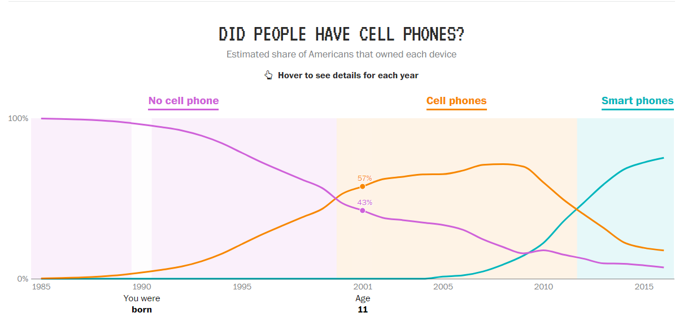
3. Gadgets
Good Equalizer
Could be used by anyone
Powerful
96% of Americans had no cellphone(1990) [3]
75% of Americans had a Smartphone(2016) [3]
“The incredibles(2004).”
Not monitoring
Syndrome only saves the best for him
Fight against the superheros, violating code of ethics 1.1
Hacking: 557 data breaches resulting in 15.3 million record exposed(2019) [4]
“What ‘Tech World’ did you grow up in?”
Notes:
Good:
Easy to use: not required high intelligence like Syndrome(pictures on the right)
Velocipod was introduced
Rocket boots ： Buddy, Incrediboy
Zero point Energy glove: Mrs. Incredible uses it to control Ominidroit’s arm
Energy prison: violet unlocks it with her hands tied up
Powerful:
They all allow Syndrome to compete, even defeat superhero levels
Stat
Easy + powerful = phone, cell phone is gadgets
Phone being equalizer:
Information is not as accessible, same access now
Communication was expensive
When you were 26 in 2016, 75% of Americans had Smartphones.
When you were born in 1990, 96% of Americans had No cell phone.
https://www.washingtonpost.com/graphics/2017/entertainment/tech-generations/
Not monitoring:
Syndrome said when the first time he fight against Mr. Incredible, saying how he become Syndrome from Incrediboy: keep all the best technology for him.
He uses to fight against the Incredible families, trying to “equalize” them down to normal people level, instead of benefiting the overall society, violates the code of ethic 1.1. He only aim to become the one superhero and eliminate all others
(1.1 Contribute to society and to human well-being, acknowledging that all people are stakeholders in computing.) . https://www.acm.org/code-of-ethics
Hacking (hacker find bugs and use it for their own benefits, instead of reporting and help the overall goods)
In 2019 the ITRC reported that hacking was the most used method of breaching data, with 577 data breaches resulting in 15.3 million records exposed.
https://www.idtheftcenter.org/annual-reports/
https://www.iii.org/fact-statistic/facts-statistics-identity-theft-and-cybercrime#:~:text=In%20the%20United%20States%2C%20the,by%20utilities%20and%20software%20companies.

Slide 11
Summary
Conclusion
Technologies
Technology is good, but only with moderation
Database
Omnidriod
Gadgets
Film Maker’s Intent
Implications
Being careless with technology is dangerous and risky
Powerful technologies were shown as out of control
Notes:
Byron
A brief summary:
Conclusion is along with Film Maker’s intent: technology is good, but with moderation, or it will be dangerous and risky
In order to support that, we introduces three kind of technologies in the movie, use them as combine with real-life data. Showing them they are powerful equalizers indeed, but also danger to people at the same time if they are being misused like Syndrome. The movie was made in 2004, but a lot of the technologies that had prototypes that are not mature for general usage at that time, but we have made progress on it.
The implication will be, the powerful technology were shown as out of control, and that increase our understanding of the importance of moderation of using technology

Slide 12
Thank You!
Any Questions?

Slide 13
RESOURCES
[1]“Database of 191 million U.S. voters exposed on Internet: researcher”. Finkle, Jim. 28 Dec 2015. https://uk.reuters.com/article/us-usa-voters-breach-idUKKBN0UB1E020151229 Accesed 2 Dec 2020.
[2] Thomas Arnold, (2018), The “big red button” is too late: an alternative model for the ethical evaluation of AI systems, Ethics and Information Technology, https://link.springer.com/article/10.1007/s10676-018-9447-7
[3]“What ‘Tech World’ did you grow up in?” Reuben Fischer-Baum, The Washington Post, Nov. 26, 2017, https://www.washingtonpost.com/graphics/2017/entertainment/tech-generations/. Accessed 2 Dec 2020.
[4]“2019 Annual Report.” Identity Theft Resources Center, 2020, https://www.idtheftcenter.org/annual-reports/. Accessed on 2 Dec 2020.
“Mr. Incredible learns the truth...” TripleKillionare. Youtube, 1 Jun 2016, https://www.youtube.com/watch?v=IRPI3lSACFc&feature=emb_logo&ab_channel=TripleKillionare. Accessed 2 Dec 2020.
“GIF africant disney pixar.”Gifer. https://gifer.com/en/2J8I. Accessed 2 Dec 2020.
“The Incredibles.” Pixar. https://www.pixar.com/feature-films/the-incredibles. Accessed 2 Dec 2020.
“The incredibles(2004).” Disney, 2004, https://www.youtube.com/watch?v=ktrwNLCUgGA. Accessed 2 Dec 2020.

